Slide 1
Inclusive Culture Overview
IDEAL Research
Donita C. Brady, Ph.D. Assistant Dean for Inclusion, Diversity and Equity in Research Training
August 20, 2021
www.med.upenn.edu/idealresearch
Twitter & Instagram: @IDEAL_Research

Slide 2
Principles of Inclusion, Diversity, & Equity in
Penn Medicine Research Community
Diversity is the variations in identities that exist within the Penn Medicine research training community with an emphasis on increasing the representation of individuals that have been traditionally disadvantaged or are historically underrepresented in research and medicine.
Inclusion is our commitment to initiatives, strategies, and behaviors within the Penn Medicine research training community that allow for respectful engagement and embracement of the diversity of its members.
Equity is our implementation of policies that ensure members of the Penn Medicine research training community from marginalized identities have access to the same opportunities to grow, contribute, and develop within it.
www.med.upenn.edu/idealresearch
Twitter & Instagram: @IDEAL_Research

Slide 3
IDEAL Research: Mission, Objectives, & Vision
The Mission of IDEAL Research is to ensure alignment between innovation and impact in biomedical research with a commitment to inclusion, diversity, and equity that is necessary for research excellence by valuing, engaging, and embracing the diversity of identity within the Penn Medicine research community and ensuring access to opportunities to individuals from marginalized identities to grow, contribute, and develop within it.
The Objectives of IDEAL Research are:
  i) Provide research training opportunities to undergraduates and post-baccalaureate scholars
  ii) Recruit the next generation of biomedical research trainees
  ii) Establish community driven support networks for trainee advocacy
  iv) Facilitate opportunities for community engagement and outreach
  v) Lead in grant administration and program evaluation
The Vision of IDEAL Research is to create, nurture, and maintain a Penn Medicine research community that embodies diversity, values inclusivity, and promotes equity.
www.med.upenn.edu/idealresearch
Twitter & Instagram: @IDEAL_Research

Slide 4
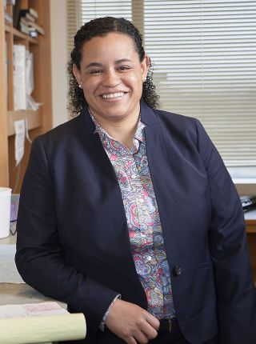

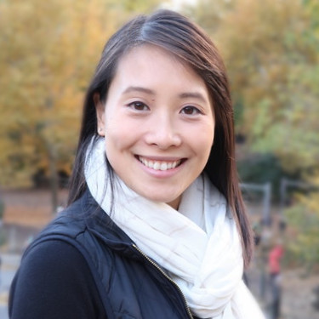
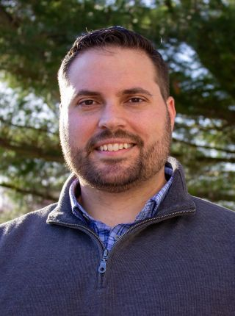
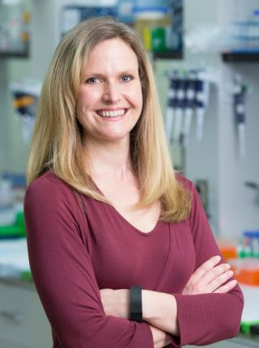
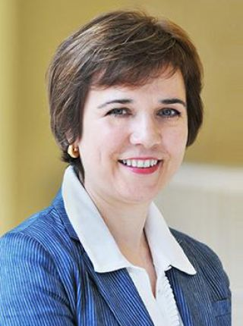
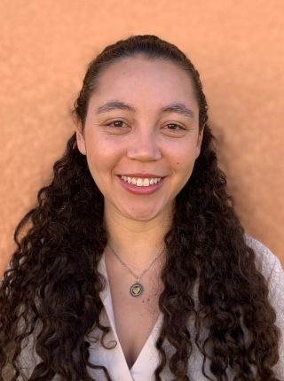
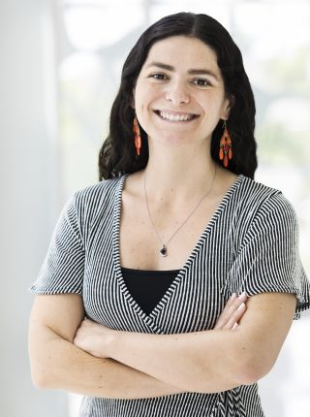
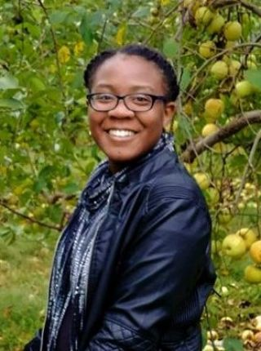
IDEAL Research: Our Team
Donita C. Brady Ph.D.
Assistant Dean for
Inclusion, Diversity, & Equity
in Research Training
Coming Soon
Administrative Director
Lisa Lim, M.A.
Assistant Director for
Research Training
Programs
Paul Tichenell, Ph.D.
Assistant Director of
Trainee Recruitment
Kelly Jordan-Sciutto, Ph.D.
Faculty Director, PREP
Mariella De Biasi, Ph.D.
Faculty Director, SUIP
Vanessa Martinez Penn
Administrative Coordinator
Vanessa Fleites
IDEAL Research Lead SUIP Fellow
Maya Hale
IDEAL Research Lead PREP Fellow
www.med.upenn.edu/idealresearch
Twitter & Instagram: @IDEAL_Research

Slide 5
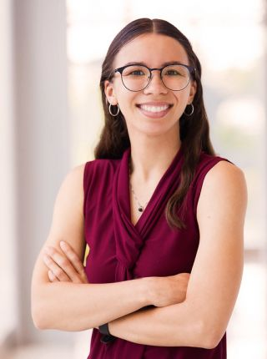
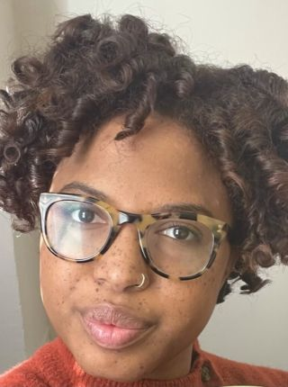
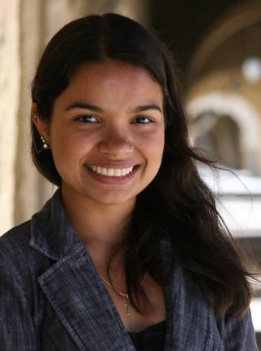
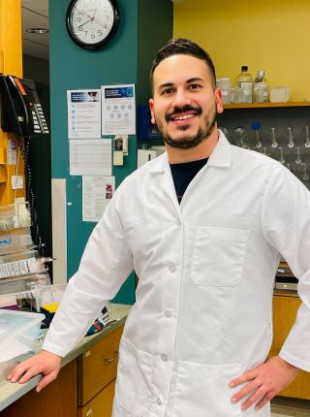
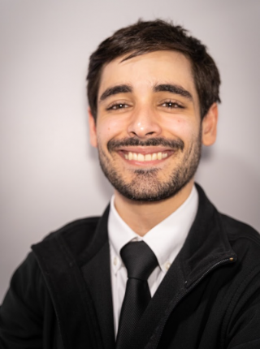
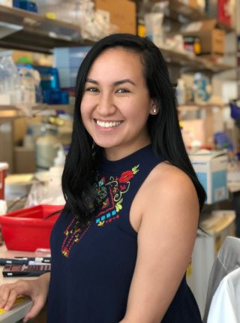
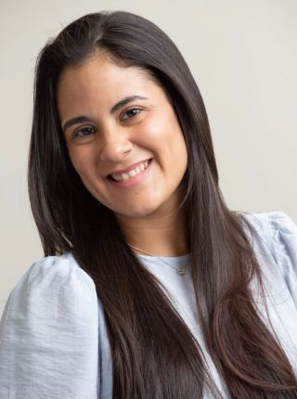
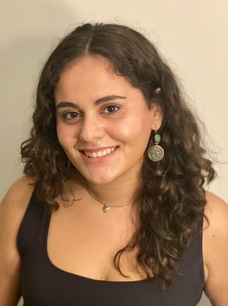
IDEAL Research Fellows
Facilitate SUIP and Penn PREP program design with Assistant Director of Research Training Programs, Lisa Lim, and Faculty Directors of SUIP and Penn PREP
Serve as research training mentors and professional development guides for SUIP interns and Penn PREP scholars
Support recruitment activities at national symposia and recruit visits to HBCUs, MSIs, and other colleges and universities.
Serve as members of Trainee Advocacy Alliance that provides provides trainee support for diverse members of the Penn Medicine research training community, especially those holding identities that are historically underrepresented in the biomedical sciences.
Bailey Nance
Courtney Marshall, Ph.D.
Emily Stephanie
Cribas
Franklin D.
Staback-Rodriguez
Jose J. Gorbea
Colon
Kahealani (Kahea)
Uehara
Kyabeth
Torres-Rodriguez
Maria Fernanda
Carrera Rodriguez
www.med.upenn.edu/idealresearch
Twitter & Instagram: @IDEAL_Research

Slide 6
IDEAL Research Initiatives
Trainee Advocacy Alliance
  Purpose: Provide trainee support for diverse members of the Penn Medicine research training community, especially those holding identities that are traditionally underrepresented in the biomedical sciences facing difficult situations like bias, microaggression, or discrimination and help trainees navigate the resources available to them at Penn.
  Participants: Collaborative network of graduate students, postdoctoral fellows, IDEAL Research fellows & staff, and faculty
  Leadership Structure: Graduate students, postdoctoral fellows, and faculty with a dedicated faculty Assistant Director for Trainee Advocacy
Recruitment Ambassadors Program
  Purpose: Contribute to recruitment activities to support IDEAL Research affiliated SUIP, Penn PREP, Penn PORT, BGS, and BPP and SUIP intern admissions process at national symposia and recruit visits to HBCUs, MSIs, and other colleges and universities.
  Participants: Collaborative network of graduate students, IDEAL Research fellows & staff, and faculty
  Leadership Structure: Assistant Director of Research Training Programs, Assistant Director for Recruitment & Outreach, and lead IDEAL Research fellows
www.med.upenn.edu/idealresearch
Twitter & Instagram: @IDEAL_Research

Slide 7
IDEAL Research: Contact Us
Web: www.med.upenn.edu/idealresearch
Twitter: @IDEAL_Research
Instagram: @IDEAL_Research
Donita Brady: bradyd@pennmedicine.upenn.edu
Lisa Lim: lisa.lim@pennmedicine.upenn.edu
Vanessa Martinez Penn: vanessa.martinezpenn@pennmedicine.upenn.edu
www.med.upenn.edu/idealresearch
Twitter & Instagram: @IDEAL_Research

Slide 8
Trainee Advocacy Alliance
An IDEAL Research Initiative
Sarah Maddux
August 20, 2021
www.med.upenn.edu/idealresearch/taa
Twitter & Instagram: @IDEAL_Research

Slide 9

Who Are We?
TAA is a network of graduate students and faculty members from across BGS committed to providing support to trainees from backgrounds historically excluded from science, especially when they are facing discrimination or distress.
All TAA members complete about 12 hours of trainings in:
  Restorative Justice
  Inclusive Mentorship
  Racial Literacy
  iCare
www.med.upenn.edu/idealresearch/taa
Twitter & Instagram: @IDEAL_Research

Slide 10
When can we help?
Any time a trainee is facing discrimination, distress, or conflict related to or informed by their identity as a member of a historically excluded group.
Examples:
  A PI who interrupts and talks over his female lab members
  An instructor who makes fun of an international student’s accent
  A lab mate who uses racist or homophobic slurs
www.med.upenn.edu/idealresearch/taa
Twitter & Instagram: @IDEAL_Research

Slide 11

What can we do?
Provide a supportive environment to discuss the incident
Provide guidance & planning
  Email review
  Role playing
Referral to official Penn resources
Connection to mediation services
Direct intervention or mediation
Incident reporting (only if desired)
www.med.upenn.edu/idealresearch/taa
Twitter & Instagram: @IDEAL_Research

Slide 12
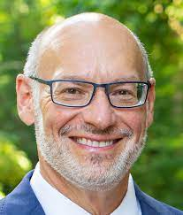
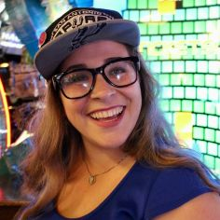
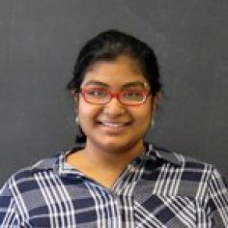
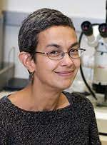
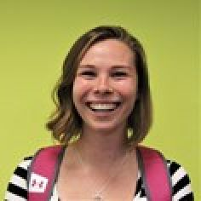
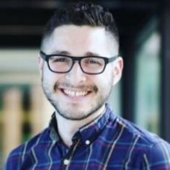
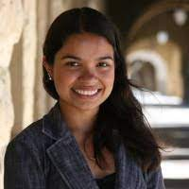
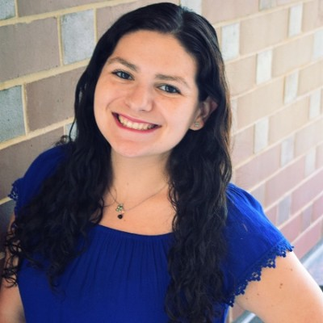
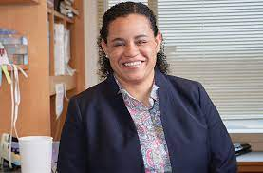
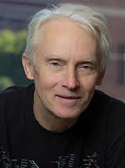
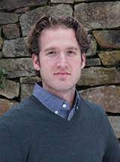
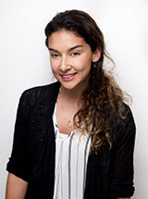
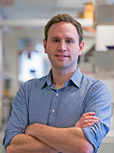
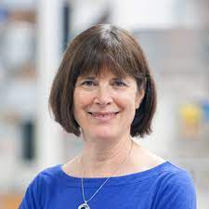
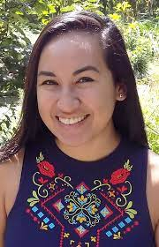
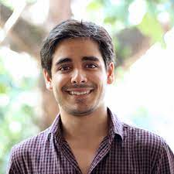
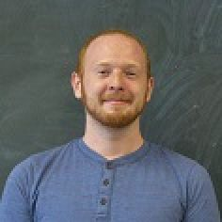
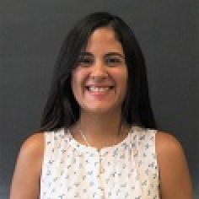
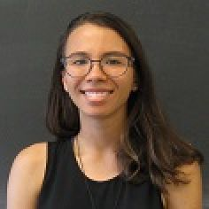
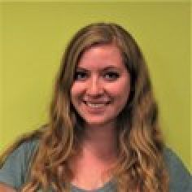
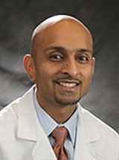
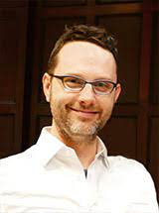
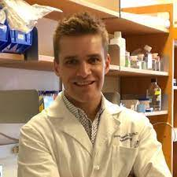
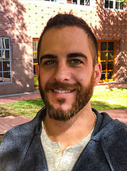
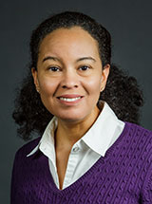
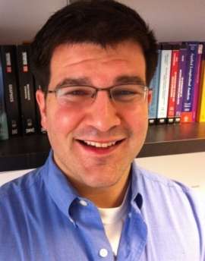

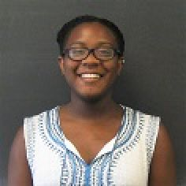
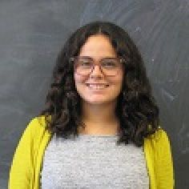
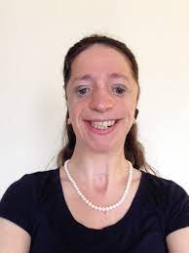
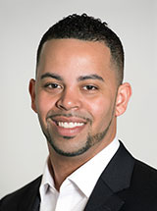
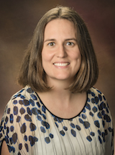
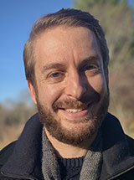
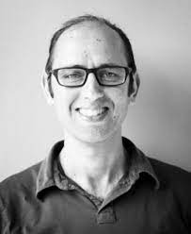
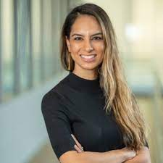









Feel free to reach out
Vanessa Martinez Penn (she/her) - Administrative Coordinator, Vanessa.martinezpenn@pennmedicine.upenn.edu
Maddux (she/her) - TAA Leadership Team, skmaddux@pennmedicine.upenn.edu
Prioty Sarwar (she/they) TAA Leadership Team, priotyf@pennmedicine.upenn.edu
TAA Faculty & Student Leadership
DSRB
IGG
MVP
DSRB
MVP
MVP
MVP
NGG
BMB/
CB/PGG
BMB
CB/IGG
BMB/
CB/PGG
CPM
DSRB
BMB
BMB
CB
CB
CB
CPM
DSRB
GCB
G&E
G&E/NGG
GGEB
GGEB
DSRB
DSRB
G&E
GGEB
GTV/
IGG/PGG
IGG/MVP
IGG/MVP
IGG/MVP
IGG/MVP
MVP
GTV
GTV
IGG
IGG
IGG
MVP
IGG/
MVP/PGG
G&E/PGG/
NGG/
www.med.upenn.edu/idealresearch/taa
Twitter & Instagram: @IDEAL_Research

